Slide 1
What to remember from exercises
General
Cluster results are sensitive to the parameter settings (threshold to cut the tree for hierarchical clustering and number of clusters for K means)
Cluster results can be visualized by a heatmap in either the ‘original space’ or the ‘rescaled space’
With K means different runs give different results even when the same parameters are being used
Rescaling data and effect on clustering
Cluster results with correlation distance on the original space and the rescaled space are exactly the same (also best visible with hierarchical clustering)
Cluster results with Euclidean distance in the rescaled space and correlation are exactly the same (a least when using hierarchical clustering p 9 and 20)
Cluster results with Euclidean distance on the original space and the rescaled space are different (also best visible with hierarchical clustering) (see slides)
Directionality of the matrix
Clustering can be performed in the gene or in the patient direction (depends on whether the datamatrix was transposed)

Slide 2
Patients/conditions =observations
Patients/conditions = variables
P1 P2 P3 P4 … Pm
P1 P2 P3 P4 … Pm
G1
G1
G2
G2
…
…
G3
G3
Genes = variables
G4
Genes = observations
G4
Gn
Gn
Patient profiles
Gene profiles

Slide 3
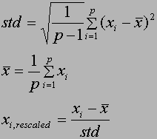
Mean centering
expressie
A’’
…
1
2
3
n
X=0
x11
x12
x13
x14
x1n
Variance rescaling
rescaling
expressie
…
A’’
1
2
3
n
X=0
x11
x12
x13
x14
x1n

Slide 4
A’’
X2
X2
A’’
A’
A’
A
A
X 1
X 1
Euclidean distance <> 0
Pearson correlation = 1
Euclidean distance = 0
Pearson correlation = 1

Slide 5
Effect of distance metrics/rescaling on cluster results
Cluster results with correlation distance on the original space and the rescaled space are exactly the same (also best visible with hierarchical clustering) p2
Cluster results with Euclidean distance in the rescaled space and correlation are exactly the same (a least when using hierarchical clustering p 9 and 20)
Cluster results with Euclidean distance on the original space and the rescaled space are different (also best visible with hierarchical clustering)
Why would this best be visible with the hierarchical clustering?

Slide 6
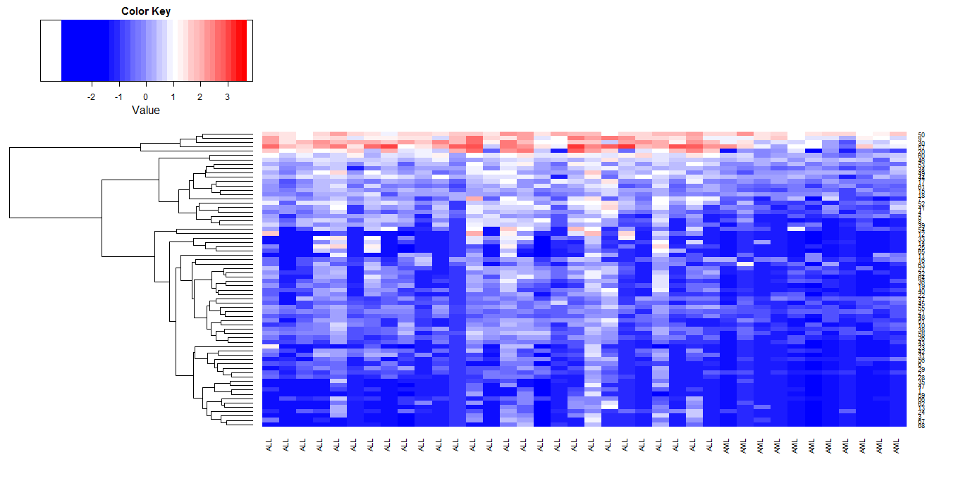
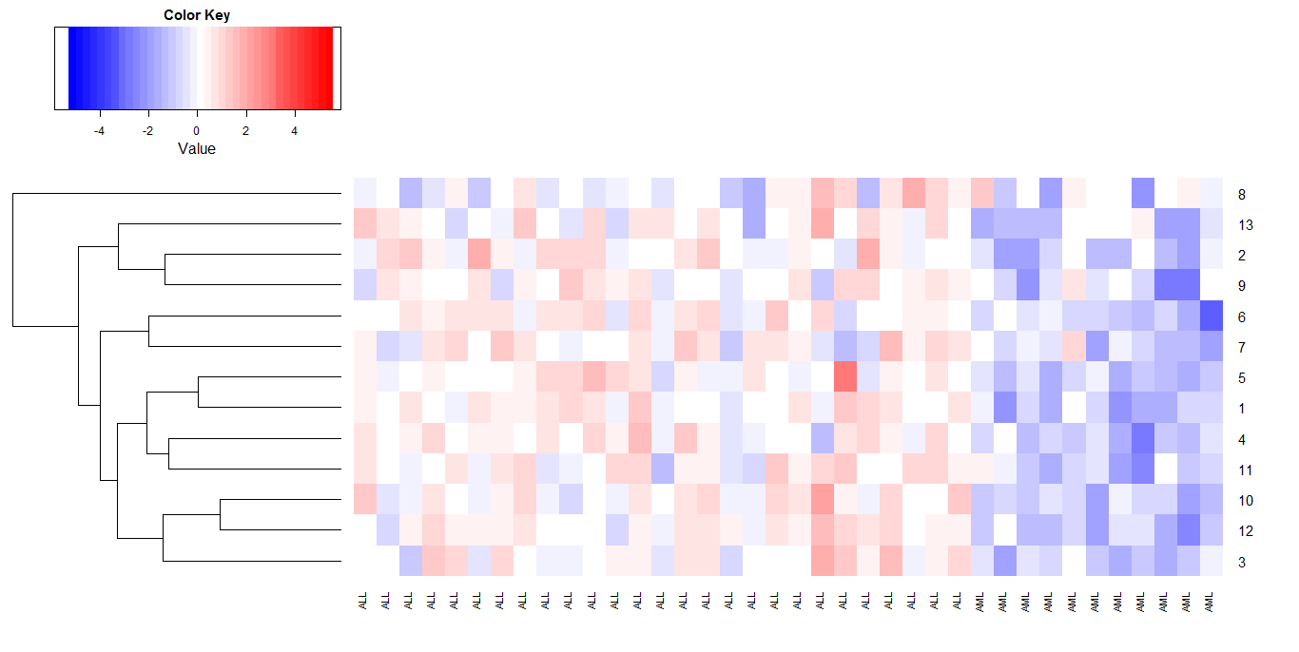
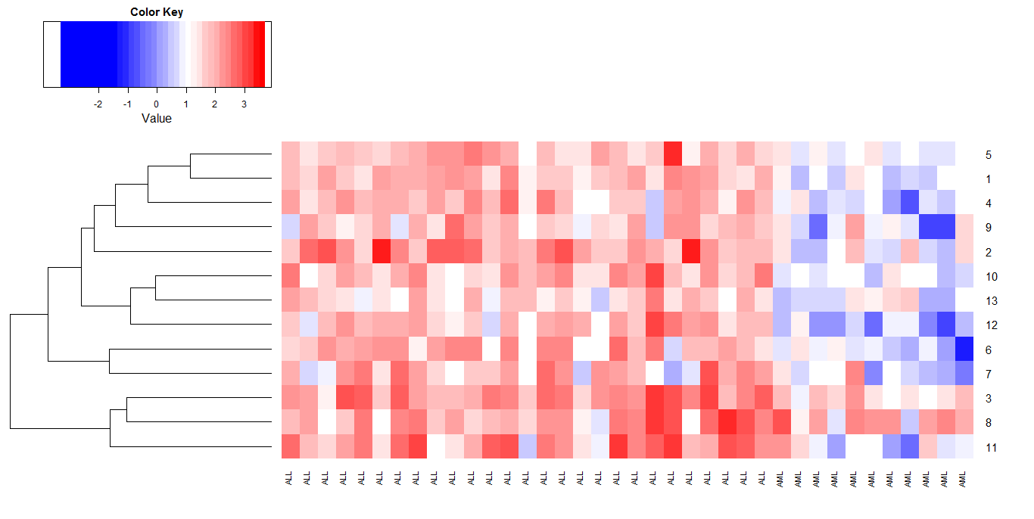
Hierarchical clustering using Euclidean distance on the rescaled data (100 clusters, query gene)
Plotted in the original space
Plotted in the rescaled space
Hierarchical clustering using Euclidean distance on the original data
Plotted in the original space
Plotted in the rescaled space

Slide 7
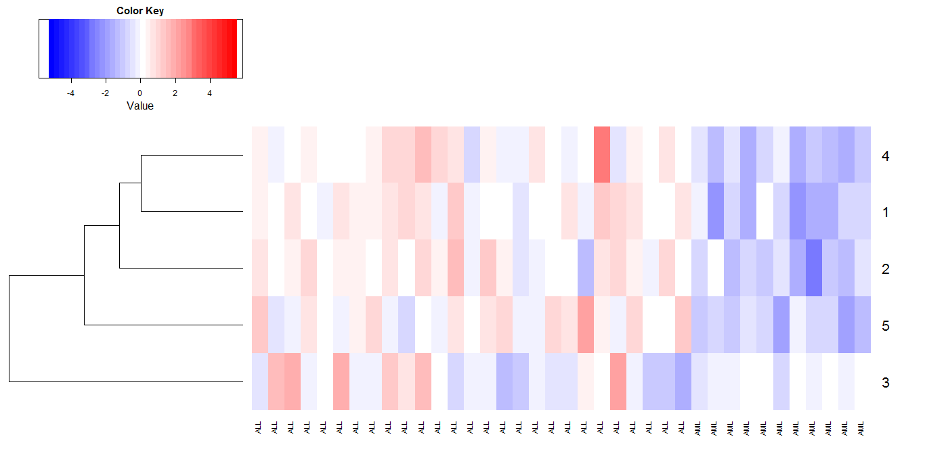
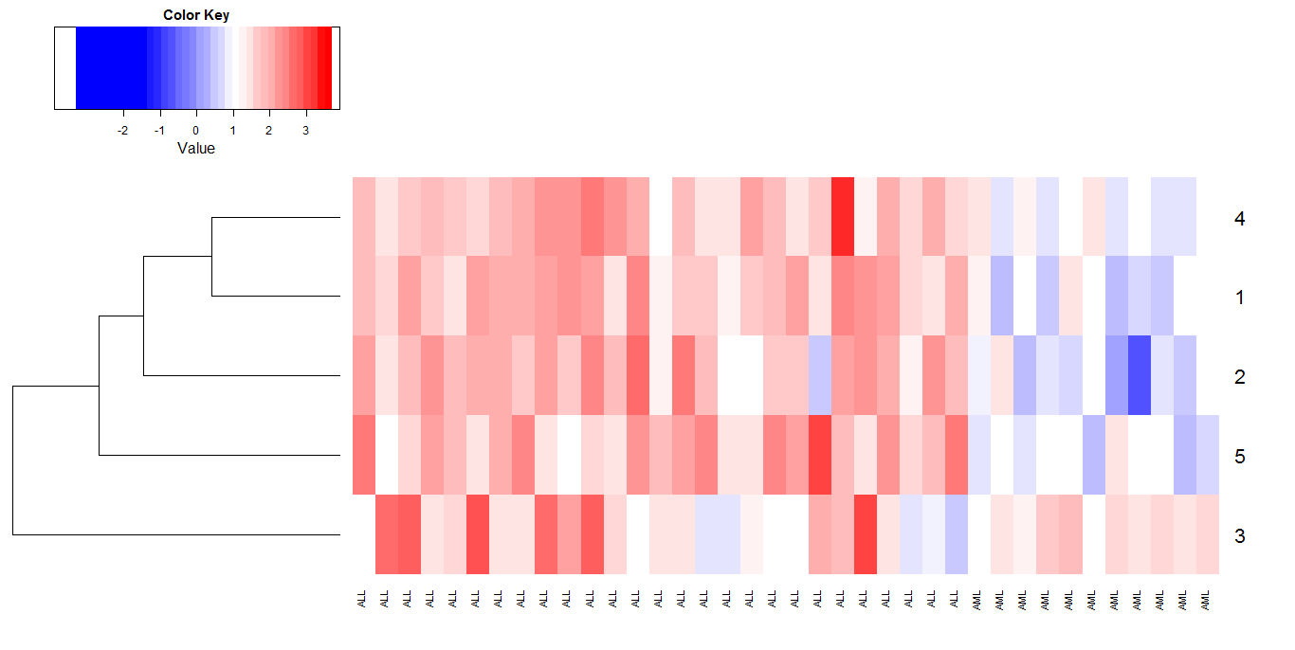
K-Means clustering using Euclidian distance on the original data (500 clusters, query gene)
Plotted in the original space
Plotted in the rescaled space
K-means clustering using Euclidian distance on the rescaled data
This one could never be detected by clustering in the original space
Plotted in the original space
Plotted in the rescaled space

Slide 8
K-means (correlation)
kmeangolub100$cluster[1042]
tmp.data <-golub
breaks.tmp <- seq(min(tmp.data), max(tmp.data), length=(40+1) )
heatmap.2(golub[which(kmeangolub100$cluster == kmeangolub100$cluster[1042]
),], col=bluered(40), scale="none", density.info='none', trace="none", breaks=breaks.tmp)
Run1
What is this code doing. If you rerun K means, will the query gene end up in the same cluster? Why/ why not
Run2
If you look at the gene level: some genes reoccur together with the query genes
in the different clusters : stable signals!

Slide 9
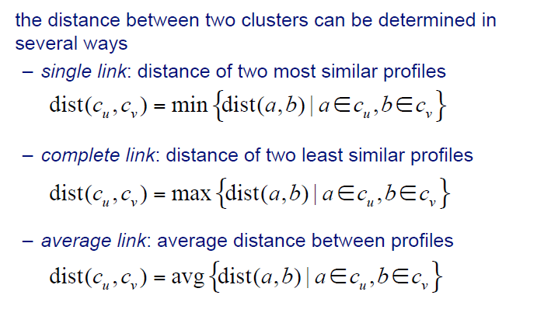
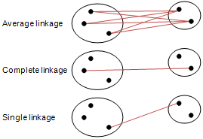
Hierarchical clustering
cu
cv

Slide 10
Hierarchical clustering
What is the following code doing?, what happens if I choose k=100?
d.correlation <- as.dist(1 - cor(t(golub)))
hclust.correlation <- hclust(d.correlation, method = ‘complete’)
clusters.correlation10 <- cutree(hclust.correlation, k=10)
table(clusters.correlation10)
#1 2 3 4 5 6 7 8 9 10
#308 237 258 580 315 464 345 238 235 71
#308 + 237+ 258 +580+ 315 +464+ 345+ 238+ 235 + 71 =3051

Slide 11
Hierarchical clustering
table(clusters.correlation100)
1 2 3 4 5 6 7 8 9 10 11 12 13 14 15 16 17 18 19 20
23 62 45 68 29 9 16 75 101 52 29 114 32 10 11 26 30 28 19 24
21 22 23 24 25 26 27 28 29 30 31 32 33 34 35 36 37 38 39 40
68 34 27 35 22 60 15 49 42 81 39 55 72 26 70 54 44 48 25 22
41 42 43 44 45 46 47 48 49 50 51 52 53 54 55 56 57 58 59 60
33 45 36 29 25 19 85 22 19 11 23 26 7 44 33 15 28 42 18 34
61 62 63 64 65 66 67 68 69 70 71 72 73 74 75 76 77 78 79 80
25 27 12 23 26 46 24 19 12 14 13 11 28 24 17 50 15 13 22 44
81 82 83 84 85 86 87 88 89 90 91 92 93 94 95 96 97 98 99 100
13 8 28 18 24 15 16 10 7 18 15 26 16 12 14 17 14 10 12 8

Slide 12
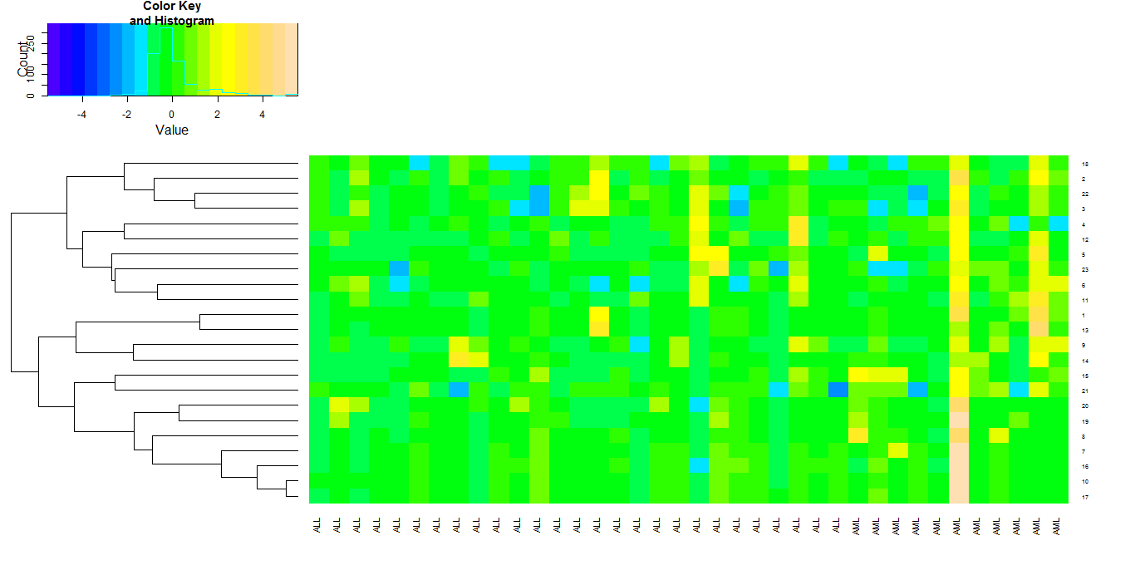
Hierarchical clustering
heatmap.2(golub_rescaled[which(clusters.correlation100==1),], scale="none", cexRow=0.5, cexCol=0.8, col=topo.colors(20), trace="none", Colv=FALSE, dendrogram = ‘row’)
Default plot in the rescaled space

Slide 13
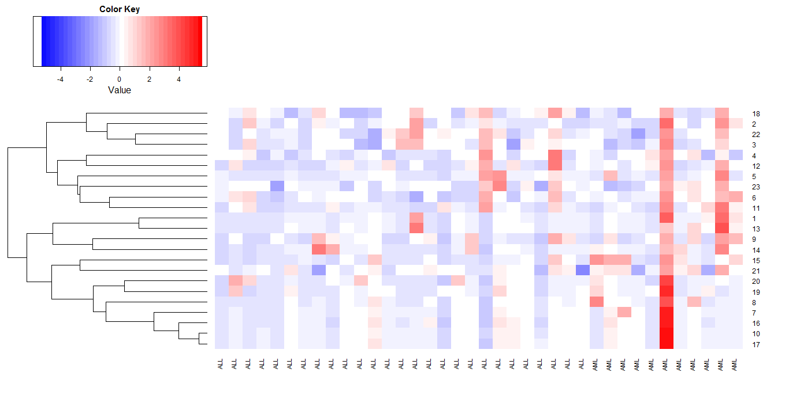
Hierarchical clustering
#color scheme fixed based on the global rescaled dataset (-5 en 5 is de range)
tmp.data <-golub_rescaled
breaks.tmp <- seq(min(tmp.data), max(tmp.data), length=(40+1) )
heatmap.2(golub_rescaled[which(clusters.correlation100==1),], col=bluered(40), scale="none", density.info='none', trace="none", breaks=breaks.tmp)
Cluster 1
Cluster to which biomarker belongs
Advantage of the rescaled plots:
Comparison between cluster results possible

Slide 15
K-means
kmeangolub10 = kmeans(d.correlation,10)
table(kmeangolub10$cluster)
1 2 3 4 5 6 7 8 9 10
183 234 282 365 302 338 327 431 250 339
183 + 234 + 282 + 365 + 302 + 338+ 327+ 431 +250 +339
=3051 (dim(golub)
kmeangolub100= kmeans(d.correlation,100)
table(kmeangolub100$cluster)
1 2 3 4 5 6 7 8 9 10 11 12 13 14 15 16 17 18 19 20
38 28 40 25 36 42 37 27 36 30 17 21 25 25 24 34 33 38 23 28
21 22 23 24 25 26 27 28 29 30 31 32 33 34 35 36 37 38 39 40
24 39 30 24 61 31 27 25 28 30 25 29 43 21 28 17 49 48 24 29
41 42 43 44 45 46 47 48 49 50 51 52 53 54 55 56 57 58 59 60
32 35 28 23 29 21 18 25 34 36 26 27 24 32 33 30 29 41 57 46
61 62 63 64 65 66 67 68 69 70 71 72 73 74 75 76 77 78 79 80
Similar to hierarchical clustering K means assigns all genes to clusters/ the number of clusters you define determines the size of the clusters

Slide 17
What to expected from exam
General questions:
  What is guilt by association
Yes/ no questions
  Clustering with K Means and the correlation metric gives different results when applied to the original versus the rescaled data
Exercises
  What is this code doing
d.correlation <- as.dist(1 - cor(t(golub)))
hclust.correlation <- hclust(d.correlation, method = ‘complete’)
clusters.correlation10 <- cutree(hclust.correlation, k=10)

Slide 18
PCA

Slide 19
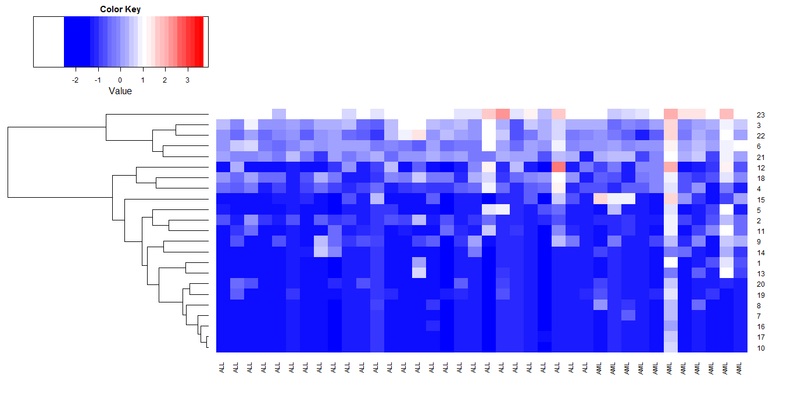
Hierarchical clustering
#color scheme fixed based on the global dataset (-1.6, 3.8)
tmp.data <-golub
breaks.tmp <- seq(min(tmp.data), max(tmp.data), length=(40+1) )
heatmap.2(golub[which(clusters.correlation100==1),], col=bluered(40), scale="none", density.info='none', trace="none", breaks=breaks.tmp, Colv=FALSE, dendrogram = ‘row’)
#color scheme fixed based on the global rescaled dataset (-1.6, 3.8)
tmp.data <-golub_rescaled
breaks.tmp <- seq(min(tmp.data), max(tmp.data), length=(40+1) )
heatmap.2(golub_rescaled[which(clusters.correlation100==1),], col=bluered(40), scale="none", density.info='none', trace="none", breaks=breaks.tmp, Colv=FALSE, dendrogram = ‘row’)
Given two codes and their results. What is the difference ?What can you observe from the different plots

Slide 20
Hierarchical clustering
Hierarchical clustering/ correlation/500 clusters (p10)
golub.gnames[which(clusters.correlation500 == clusters.correlation500[1042]),2]
[1] "KIAA0216 gene"
*[2] "Calmodulin Type I"
[3] "Terminal transferase mRNA"
*[4] "CCND3 Cyclin D3"
[5] "TFIID subunit TAFII55 (TAFII55) mRNA"
[6] "Hlark mRNA"
[7] "mRNA (clone C-2k) mRNA for serine/threonine protein kinase"
[8] "NUCLEAR FACTOR RIP140"
* [9] "PROBABLE G PROTEIN-COUPLED RECEPTOR LCR1 HOMOLOG"
[10] "Transcriptional activator hSNF2b"
Genes closest to the ‘query gene’ in the absolute space and in the rescaled space (on which the clustering was based) -> rescaling will affect the clustering

